Slide 1


Data
Preprocessing
Workshop
Presented by: Imène ALLOUCHE

Slide 2
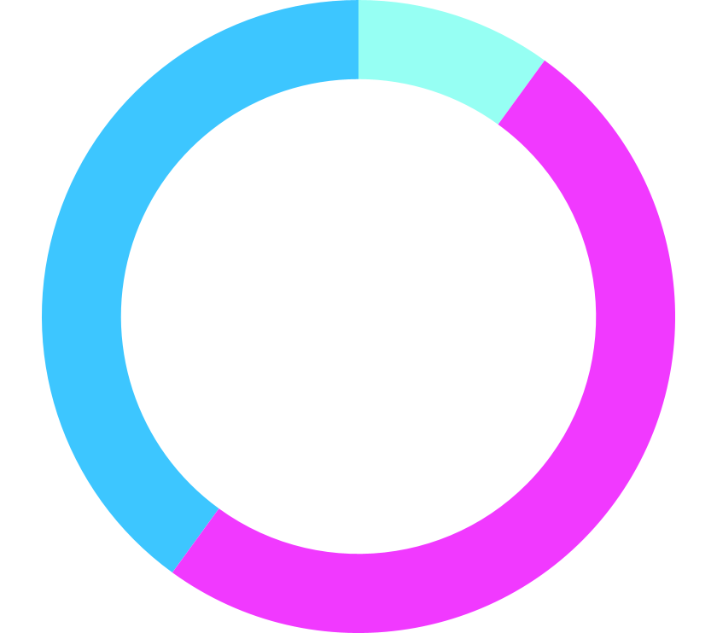
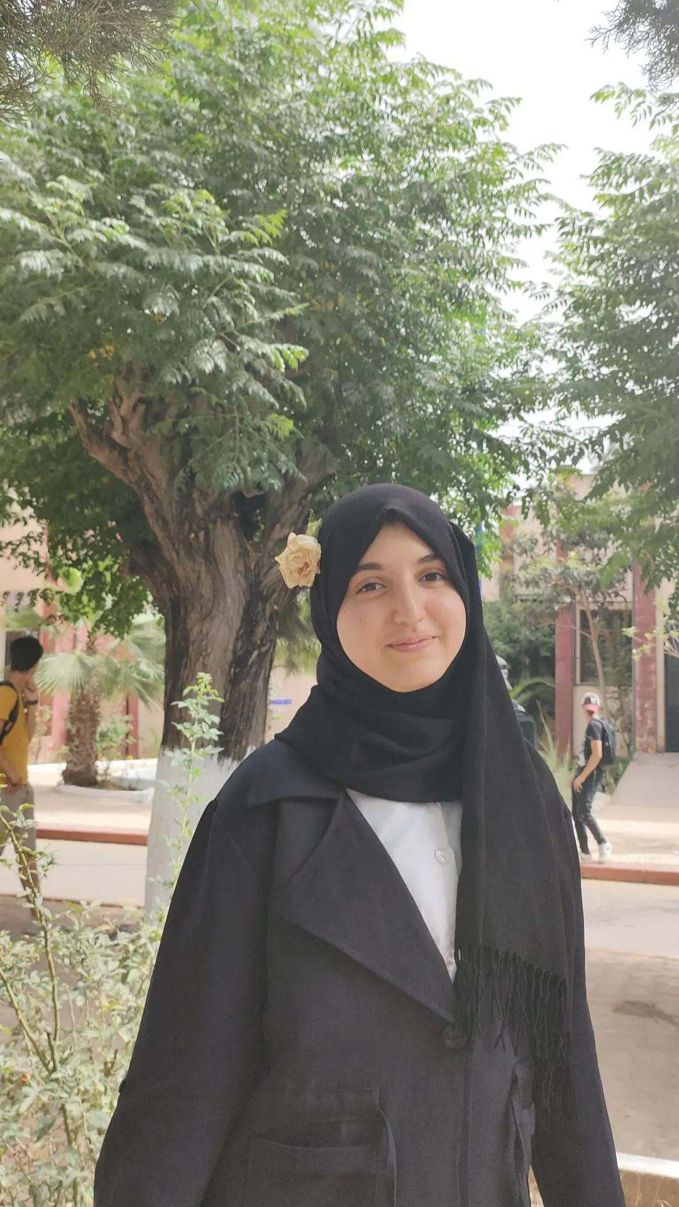
WHO AM I ?
Imène ALLOUCHE
2CP student at ESI Algiers
Artificial Intelligence enthusiast

Slide 3
TABLE OF CONTENTS
01
What is DP
03
Steps of DP
02
04
Practise
Why DP
What is Data Preprocessing
Walkthrough to DP
Why do we preprocess data?
Challenges to get hands dirty

Slide 4

01.
What is
Data Preprocessing

Slide 5

WHAT IS A DATASET
Gender | Blood Cancer | Blood type
Male | positive | AB+
Female | positive | A+
Female | negative | A-
Male | positive | A+
Male | positive | A+
Male | negative | O+

Slide 6
Data Preprocessing
Data cleaning
Data transformation
Data standardization
.
.
.

Slide 7

02.
Why
Data Preprocessing

Slide 8
Garbage IN
Garbage OUT

Slide 9
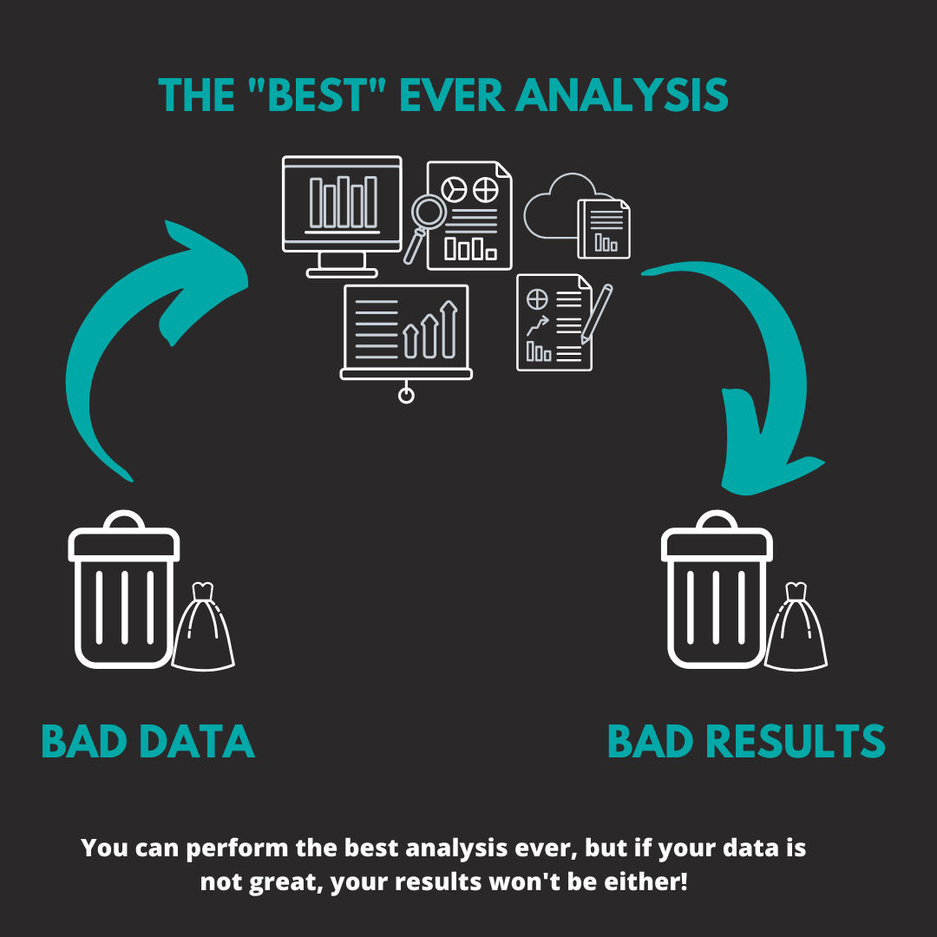
Garbage IN
Garbage OUT

Slide 10
03.
Steps of
Data Preprocessing

Slide 11
Data cleaning
Data Transformation
Data Standardization
Missing Values
Duplicates
From categorical to numerical
Scaling data
Data normalization
Duplicates
Irrelevant data

Slide 12
DATA
CLEANING

Slide 13
DATA CLEANING
Removing
Duplicates
Handling missing values
Correcting typos

Slide 14
Name | Gender | Class | Note /20
Isaac Newton | Male | 19 | 18
Albert Einstein | Male | 20 | 11
Thomas Edison | Male | 20 | 12
Isaac Newton | Male | 19 | 18
Nicola Tesla | Male | 19 | 10

Slide 15
Name | Gender | Class | Note /20
Isaac Newton | Male | 19 | 18
Albert Einstein | Male | 20 | 11
Thomas Edison | Male | 20 | 12
Nikola Tesla | Male | 19 | 10

Slide 16
WHY DATA DEDUPLICATION ?
Decrease storage capacity requirements
Improve the quality of training data

Slide 17
DATA CLEANING
Removing
Duplicates
Handling missing values
Correcting typos

Slide 18
Name | Country | Age | situation
Baek-Hyun | SouthKorea | 45 | critical
Yan | china | 24 | Under control
Seo-Jun | South Korea | 39 | critical
Jung | CHINA | 65 | critical
Alex | USA | 10 | Under control
Felix | United States | 30 | Under control

Slide 19
Name | Country | Age | situation
Baek-Hyun | South korea | 45 | critical
Yan | china | 24 | Under control
Seo-Jun | South korea | 39 | critical
Jung | china | 65 | critical
Alex | usa | 10 | Under control
Felix | usa | 30 | Under control

Slide 20
WHY INCONSISTENT DATA ENTRIES ?
Exactness of results of the model

Slide 21
DATA CLEANING
Removing
Duplicates
Handling missing values
Correcting typos

Slide 22
MISSING VALUES
NaN
Venus
Not recorded
Don’t exist
Fill them
Keep Them to NaN

Slide 23
Student Name | Gender | Weight | Driving licence ID
Imène | Female | 65kg | NaN
Hind | Female | NaN | 0019754831
Firas | Male | 70kg | NaN
Oussama | Male | NaN | 0018756314
Ibtissam | Female | 68kg | NaN

Slide 24
Student Name | Gender | Weight | Driving licence ID
Imène | Female | 65kg | NaN
Hind | Female | 66kg | 0019754831
Firas | Male | 70kg | NaN
Oussama | Male | 70kg | 0018756314
Ibtissam | Female | 67kg | NaN

Slide 25
DATA CLEANING
Removing
Duplicates
Handling missing values
Correcting typos

Slide 26
WHY HANDLING MISSING VALUES?
Increase the performance of the model

Slide 27
DATA
TRANSFORMATION

Slide 28
DATA TRANSFORMATION
Categorical Data
Numerical Data
0
1
1
1
0
0
0
1
0

Slide 29
Student ID | Gender | Weight | Driving licence ID
210022 | Female | 65kg | NaN
210145 | Female | 66kg | 0019754831
220945 | Male | 70kg | NaN
210134 | Male | 70kg | 0018756314
210178 | Female | 67kg | NaN

Slide 30
Student ID | Gender | Weight | Driving licence ID
210022 | 1 | 65 | NaN
210145 | 1 | 66 | 0019754831
220945 | 0 | 70 | NaN
210134 | 0 | 70 | 0018756314
210178 | 1 | 67 | NaN

Slide 31
WHY DATA TRANSFORMATION?
Helps dealing with data while building the model

Slide 32
DATA
STANDARDIZATION

Slide 33
Data STANDARDIZATION
Scaling
Normalization
Transform data so that it fits within a specific scale, like 0-100 or 0-1
Change your observations so that they can be described as a normal distribution
Used in methods based on measures of how far apart data points are(KNN, SVM)
For machine models that needs normalized data: CNN,

Slide 34
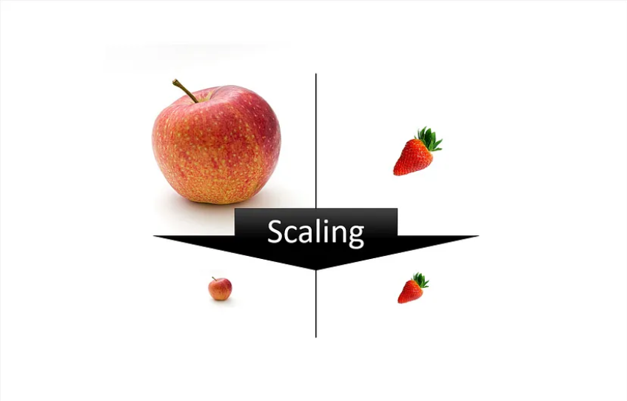
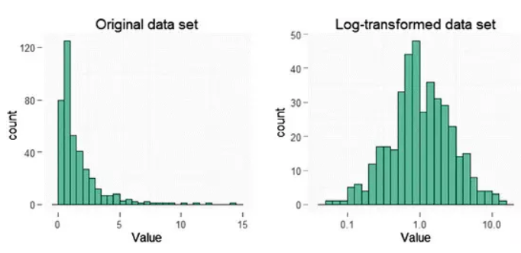
Scaling
Normalization

Slide 35
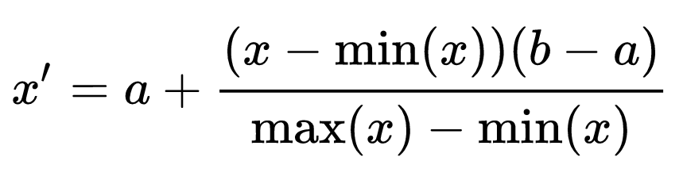
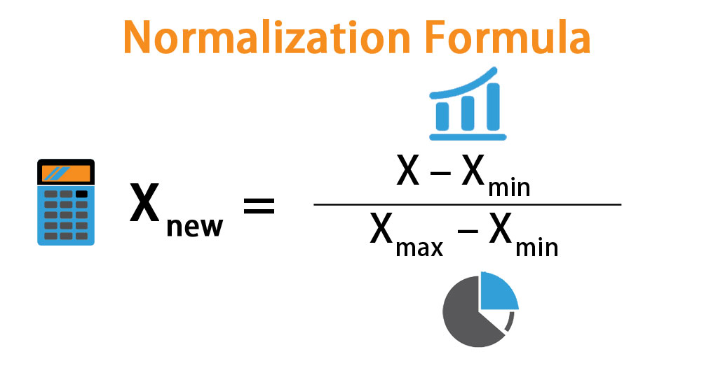
Scaling
Normalization

Slide 36
Gender | Height
1 | 172
1 | 168
0 | 180
0 | 176
1 | 159

Slide 37
Gender | Height
1 | 1.72
1 | 1.68
0 | 1.80
0 | 1.76
1 | 1.59

Slide 38
THANK YOU
FOR YOUR ATTENTION

